Slide 1

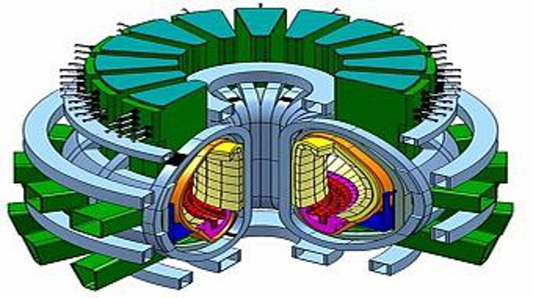

MATERIALS AND SURFACE ENGINEERING
DEPARTMENT OF CIVIL AND MECHANICAL ENGINEERING
PROJECT LEVEL: Master or Bachelor
Advanced materials for fusion reactors
SUPERVISORS
Wolfgang Pantleon
pawo@dtu.dk
Karen Pantleon
kapa@dtu.dk
COLLABORATION
EUROfusion consortium
01 / PROJECT BACKGROUND
One of the key issues in constructing fusion reactors are materials able to withstand high temperatures as well as high mechanical and radiation load. The project focusses on the microstructural property relationships of materials relevant for future fusion reactors. Tungsten and tungsten alloys are considered as sole option for the plasma facing armor of the first wall material and the divertor. In service, the materials must withstand high temperatures significantly altering their microstructure.
02 / PROJECT AIM
The replacement of the instable microstructure leads to degradation of the mechanical properties as a loss in strength and embrittlement. The aim of the project is to investigate the thermal stability of tungsten, tungsten alloys and tungsten composites processed in different manner (highly deformed by rolling or wire drawing, chemical vapor deposited, powder metallurgical or additively manufactured) with focus on the microstructural mechanisms (recovery, recrystallization and grain growth) relevant for property degradation.
03 / PROJECT ACTIVITIES
Rolled tungsten plates or drawn tungsten wires with or without potassium doping
Dispersion-strengthened tungsten by WC, ZrC, Y₂O₃
Tungsten fiber-reinforced tungsten composites (continuous vs. short fibers, porous vs. compact matrix)
04 / PRACTICAL NOTES
The microstructure and mechanical properties of the as-processed material as well as after heat treatment will be analyzed in detail by light optical microscopy, electron backscatter diffraction, and hardness testing. In-situ monitoring the changes at high temperatures by X-ray diffraction will be attempted.
DTU CONSTRUCT / MATERIALS AND SURFACE ENGINEERING

Slide 2
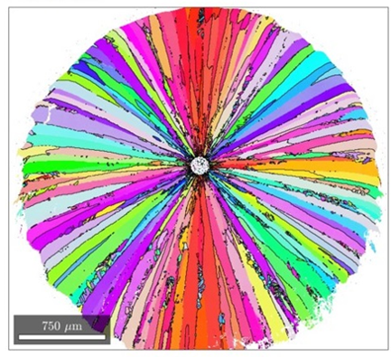
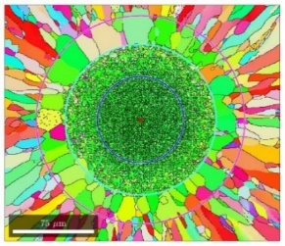
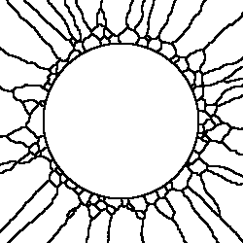
MATERIALS AND SURFACE ENGINEERING
DEPARTMENT OF CIVIL AND MECHANICAL ENGINEERING
PROJECT LEVEL: Master or Bachelor
Monte Carlo simulation of grain growth in composites
SUPERVISORS
Wolfgang Pantleon
pawo@dtu.dk
Dana Zöllner
dana.zoellner@ovgu.de
COLLABORATION
Otto von Guericke University, Magdeburg
01 / PROJECT BACKGROUND
Tungsten fiber-reinforced tungsten composites with a tungsten matrix reinforced by heavily drawn tungsten fibers are developed for future fusion reactors. During service at high operation temperatures, the microstructure of the highly deformed fibers will be altered by recrystallization and grain growth. In composites where tungsten was chemically vapor deposited on a single drawn tungsten wire, a puzzling interplay of several physical processes (recrystallization in the micrometer-sized wires and grain growth in the matrix) affects the microstructure at different length scales.
02 / PROJECT AIM
Both processes occur in a coupled fashion in the interfacial zone on an even smaller length scale. To address the coupling of multiple metallurgical processes on multiple length scales computational methods are required. The aim of the project is to perform Monte Carlo simulations of the microstructural evolution at high temperatures based on the real microstructure revealed by electron backscatter diffraction and to predict the evolving texture.
03 / PROJECT ACTIVITIES
Setting up a digital twin of the composite for MCS based on electron backscatter data
Simulating the microstructural evolution in 3D using Potts model by MCS
Variation of materials parameters to mimic the experimental observations
04 / PRACTICAL NOTES
By varying grain boundary energy and mobility as well as nucleation rates for recrystallization, the observed peculiar behavior will be rationalized, the importance of the different metallurgical process (primary vs. secondary recrystallization or abnormal grain growth) revealed and the effect of the process geometry assessed.
DTU CONSTRUCT / MATERIALS AND SURFACE ENGINEERING

Slide 3
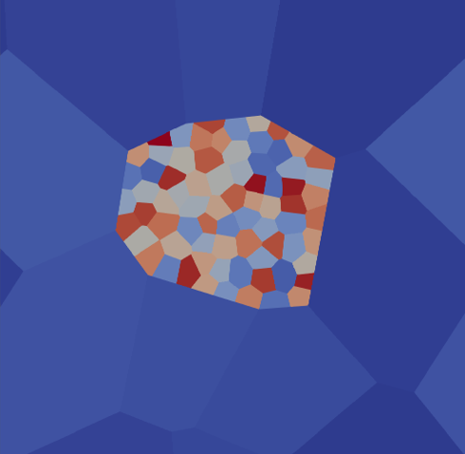
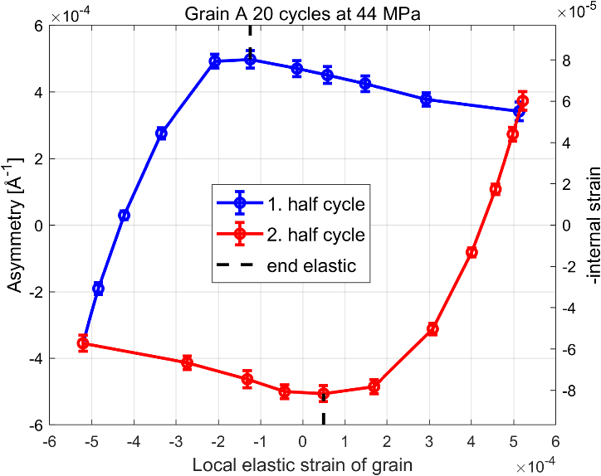
MATERIALS AND SURFACE ENGINEERING
DEPARTMENT OF CIVIL AND MECHANICAL ENGINEERING
PROJECT LEVEL: [Master or Bachelor]
Simulation of internal stresses developing during fatigue
SUPERVISORS
Wolfgang Pantleon
pawo@dtu.dk
Ricardo Lebensohn
lebenso@lanl.gov
COLLABORATION
Los Alamos National Laboratory, USA
01 / PROJECT BACKGROUND
During plastic deformation of metals, the defects carrying plastic deformation are stored in dislocation walls separating dislocation-free subgrains. A peculiar phenomenon has been discovered during fatigue when the sense of the deformation is reversed repeatedly. Even small plastic strains applied repeatedly e.g. in tension compression cycles cause formation of ordered dislocation structures which after a large number of cycles eventually lead to failure.
02 / PROJECT AIM
Simultaneously with emerging dislocation structures, internal stresses develop. Monitoring these by in-situ synchrotron diffraction during tension-compression cycles showed their increase during elastic unloading. Neither classical models, nor elasto-viscoplastic simulations have been able to rationalize this unexpected behavior. The reason has been traced to local variations of material parameters and internal stresses. Aim of the project is their incorporation in the simulation and the development of dedicated analysis to allow comparison with experimental X-ray diffraction profiles.
03 / PROJECT ACTIVITIES
Large strain elasto-viscoplastic simulations using Fast Fourier transformation approaches
Varying material properties with focus on intrinsic variability
Analyzing simulation results for distributions of local elastic strains along loading direction
04 / PRACTICAL NOTES
The project is focused on simulations and post-processing of simulation results to derive characteristic profiles which can be compared to already obtained experimental data by in-situ synchrotron diffraction.
DTU CONSTRUCT / MATERIALS AND SURFACE ENGINEERING

